Slide 1
Practice
Write -57₁₀in twos complement form 1 byte
Step 1: 57₁₀ -> unsigned binary form
1 * 32 + 1 * 16 + 1 * 8 + 1 *1
0011 1001
Step 2: flip bits
1100 0110
Step 3: add 1
1100 0111
1111111111111111 1100 0111

Slide 2
IEEE 754 floating point standard
This is a standard for the floating point numbers that are used in nearly all computers and programming languages since 1985.
Java floating point (on its virtual processor) and MIPS floating point (on real hardware) conform to this standard.
Floating point representation makes numerical computation much easier

Slide 3
Fixed Point
Binary point is assumed to lie between two of the bits
Equivalent to saying that integer the bits represent should be divided by a particular power of two
For example, the integer 2345, could represent the number 23.45. As long as you are consistent, everything works.
Tedious and error-prone

Slide 4
Exponential Terminology
Sign of the mantissa |  | Sign of the exponent
 | -0.35790 x 10⁻⁶
Location of radix point | Mantissa (Significand) |  | Base | Exponent

Slide 5
Floating Point
The essential idea of floating point representation is that a fixed number of bits are used (usually 32 or 64) and that the binary point "floats" to where it is needed in those bits.
The computer only holds bit patterns. Some of the bits of a floating point representation must be used to say where the binary point lies.
Floating point expressions can represent numbers that are very small and numbers that are very large.
When a floating point calculation is performed, the binary point floats to the correct position in the result. The programmer does not need to explicitly keep track of it.

Slide 6
History
The first digital computer (according to some) the Z3, built by Konrad Zuse in 1941 used floating point representation. This computer had a clock speed of five to ten Hertz and a memory of 64 words of 22 bits!
Many early minicomputers and microprocessors did not directly support floating point in hardware
For example, Intel processor chips before the 80486 did not directly support floating point. A floating point operation in a program (written in C) was compiled into a sequence of bit-manipulation instructions that did the required operations.
Computers used for graphics or engineering calculation often had an additional chip that performed floating point operations in hardware.

Slide 7
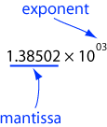
Scientific Notation
Up until 1985 each hardware manufacturer had its own type of floating point.
To address this problem the IEEE (Institute of Electrical and Electronics Engineers) created a standard for floating point in 1985
The idea of floating point comes from scientific notation for numbers
The mantissa always has a decimal point after the first digit
The mantissa always has a decimal point after the first digit.
The above expression means: 1.38502 × 1000 = 1385.02
The decimal point "floats" to where it belongs. In effect, the mantissa gives the digits and the exponent says where the decimal point should go.

Slide 8
Exponential notation
Equivalent representations of 8974
8974 x 10⁰
897.4 x 10¹
89.74 x 10²
8.974 x 10³
0.8974 x 10⁴
0.08974 x 10⁵
0.008974 x 10⁶
89740 x 10⁻¹
897400 x 10⁻²
8974000 x 10⁻³
89740000 x 10⁻⁴

Slide 9
Floating point format
Standardized formats used
Some digits used for exponent, rest for mantissa
Larger exponent means greater range of values
Larger mantissa means greater precision of values
Signed-magnitude, complementary or excess-N notation
Base of exponent and position of radix point implicit
Sign of the mantissa
SEEMMMMM
2-digit Exponent | 5-digit Mantissa

Slide 10
Precision
The number of digits in the mantissa is called the precision of the floating point number.
With a 32-bit single-precision floating point value the mantissa is 24 bits, so single precision floats have 24 bits of precision.
Caution: the mantissa uses 23 bits to represent its 24 bits of precision.

Slide 11
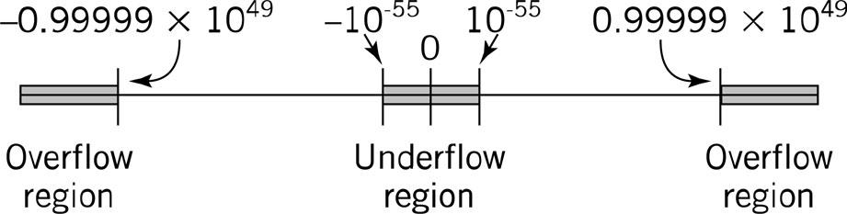
Overflow and Underflow

Slide 12
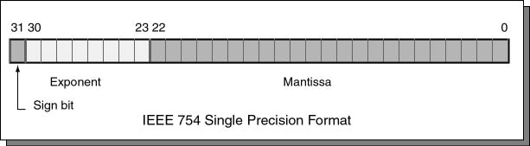
IEEE 754 Floating Point
An IEEE 754 single-precision floating point value is 32 bits long. The bits are divided into fixed-sized fields as follows:

Slide 13
Mantissa
The mantissa represents a number in 24-bit base two positional notation that looks like this: 1.xxxxxxxxxxxxxxxxxxxxxxx (x = 0 or 1; there are 23 x's)
The mantissa represents the 23-bit binary fraction part of a 24-bit number that starts with a "1". The 20 place (the one's place) is presumed to contain a 1 and is not present in the mantissa. This trick gives us 24 bits of precision with only 23 bits. For example, the binary number 1.11110000101101101010001 is represented as 11110000101101101010001

Slide 14
Mantissa Example
Since leading zeros of a binary number can be dropped, it is safe to not actually include the first 1.
Represent 00011.00101101 as a float.
Drop the leading zeros: 11.00101101 x 2^0
Now there is a leading one.Move the binary point so that the leading one is in the one's place (the exponent shows the move): 1.100101101 × 2¹
Drop the leading one: 100101101 × 2¹
Add zero bits on the right so that there are 23 bits in total: 10010110100000000000000 × 2¹
Result: the mantissa is: 10010110100000000000000

Slide 15
Exponent
The eight bits 23 through 30 contain the exponent.
The exponent is an integer, that may be negative, zero, or positive.
The exponent is expressed using a biased integer. The true exponent is added to +127₁₀ resulting in an unsigned binary integer. The biased integer is encoded using 8-bit unsigned binary.
A biased exponent of +127 represents the actual exponent 0. A biased exponent of +128 represents the actual exponent 1. A biased exponent of +126 represents the actual exponent -1

Slide 16
Float Formula
s is the sign bit (0 or 1), M is the mantissa (000...000 to 111...111) and E is the biased exponent. value = (-1)s × 1.M × 2^{E+127}

Slide 17
Exceptions
A floating point value of 0.0 is represented with a mantissa of 23 zero bits and an exponent of 8 zero bits, sign of 0.
The exponent 25510 (1111 1111) is used to signal various problems, such as division by zero.

Slide 18
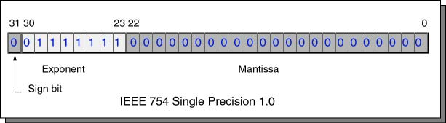
1.0 in base 10
Bit pattern is written in hexadecimal it is 0x3F800000

Slide 19
Practice
-0.1 in base 10 put in IEEE 754 32 bit format, express in hexadecimal
Figure out the sign 1
.1 x 10^0 Decimal to Binary
.1 X 2 = 0.2 = 0
.2 X 2 = 0.4 = 0
.4 X 2 = 0.8 = 0
.8 X 2 = 1.6 = 1
.6 X 1 = 1.2 = 1

Slide 20
.0001100110011001100110011001100 X 2^0
MOVE RADIX POINT
1.100110011001100110011001100 X 2^-4
Extract the mantissa
put in the exponent
127 + -4 -> 123
0111 1011
127 - 64 = 63
63 -32 = 31
31-16 = 15

Slide 21
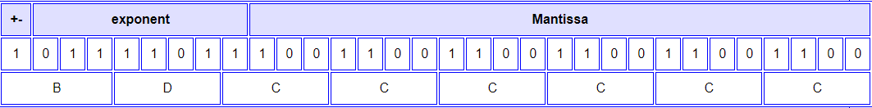
-0.1 in base 10
But let us proceed to see how -0.1 is (imprecisely) represented.
The sign bit of -0.1 is 1 (for negative).
The binary fraction for 0.1 0.0001100110011001100110011001100…
The mantissa of 0.1 is calculated by shifting the leading bit into the one's place: 1.100110011001100110011001100... The shift was 4 places left, for an exponent of -4
Drop the one bit in the one's place: .100110011001100110011001100... Retain 23 bits: 100 1100 1100 1100 1100 1100
The actual exponent is -4 The biased exponent is 127-4 = 123 = 0111 1011

Slide 22
0.1_10 x 2 -> 0.2 0
0.2 x 2 -> 0.4 0
0.4 x 2 -> 0.8 0
0.8 x 2 -> 1.6 1
0.6 x2 -> 1.2 1
0.2
.0001100110011_2

Slide 23
176_10
128 -> 2^7
176 - 128 = 48 1
64
48 - 32 = 16 1
16 - 16 = 0 1
1011 0000. 011
.375 x 2 = .75 0
.75 x 2 = 1.5 1
0.5 x 2 = 1.0 1

Slide 24
1.0110 0000 1100 x 2^7
127 + 7 -> 134
134 -128 6 1
1000 0110

Slide 25
-176.375
Observe the sign
Ignore sign and convert from base 10 to unsigned binary (include radix point)
As a sum : 2⁷ + 2⁵ + 2⁴ + 2⁻² + 2⁻³
As binary:
Convert to Scientific. Float the radix point and determine the mantissa (23 bit) and exponent
1.0110000011 x 2⁷
Exponent = 7₁₀
Mantissa = 01100000110000000000000 (had to add 13 trailing zeros)
Calculate biased exponent by adding 127₁₀
127₁₀ + 7₁₀ = 134₁₀
2⁷ + 2² + 2¹ = 134
10000110

Slide 26
-176.375
COMBINE SIGN, EXPONENT, AND Mantissa
The format is:
Sign Exponent Mantissa
(1 bit) (8 bits) (23 bits)
1 1000 0110 011 0000 0110 0000 0000 0000
1100 0011 0011 0000 0110 0000 0000 0000 (Hex : 0xc3306000)

